Slide 1
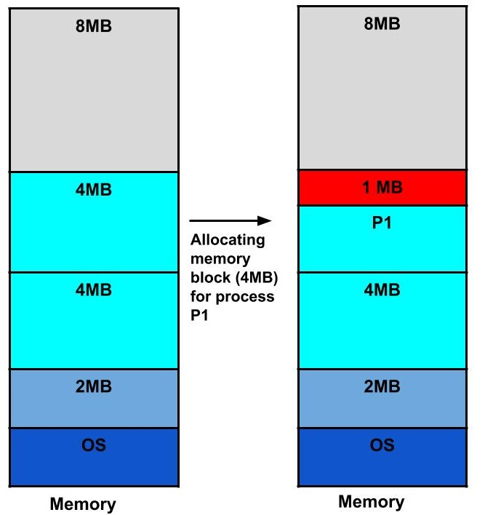

Slide 2
Suppose there is fixed partitioning (i.e. the memory blocks are of fixed sizes) is used for memory allocation in RAM. These sizes are 2MB, 4MB, 4MB, 8MB.
Now, suppose a process P1 of size 3MB comes and it gets memory block of size 4MB. So, the 1MB that is free in this block is wasted and this space can’t be utilized for allocating memory to some other process. This is called internal fragmentation.

Slide 3
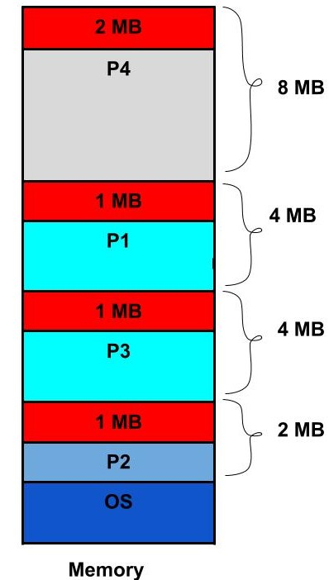

Slide 4
Suppose in the above example, if three new processes P2, P3, and P4 come of sizes 2MB, 3MB, and 6MB respectively. Now, these processes get memory blocks of size 2MB, 4MB and 8MB respectively allocated.
So, now if we closely analyze this situation then process P3 (unused 1MB)and P4(unused 2MB) are again causing internal fragmentation. So, a total of 4MB (1MB (due to process P1) + 1MB (due to process P3) + 2MB (due to process P4)) is unused due to internal fragmentation.
Now, suppose a new process of 4 MB comes. Though we have a total space of 4MB still we can’t allocate this memory to the process. This is called external fragmentation.

